Slide 1
Polarized Ion Sources
Anatoli Zelenski, BNL
Polarization techniques.
Polarized proton (deutron) H⁻(D⁻) sources.
Polarized ³He⁺⁺ ion sources.
Polarized heavy (radioactive) ion beams .
USPAS-2020

Slide 2
High intensity polarized H⁻ ion source and “Siberian Snakes” made possible the high luminosity RHIC operation with colliding polarized protons beams to study:
proton spin structure,
fundamental tests of QCD and electro-weak interaction.

Slide 3
Electron, proton beam polarization
Electrons and protons have intrinsic angular momentum - Spin: S=1/2 and magnetic moments aligned with spin.
According to quantum mechanics: electron (or proton) spin can have only two projections (m_{s} =+1/2 or –1/2) on the axis defined by magnetic field direction.
N⁺ -N⁻
P =
N⁺ +N⁻
N⁺/N⁻ =3, P=50%
External magnetic field direction

Slide 4
Polarization techniques
Spin filtering:
1. Focusing(defocusing) of atomic beam by sextupole magnets. ABS
2. Selective quenching of metastable atomic states.
3. Cross-section difference for opposite spin direction. Antiprotons.
Optical pumping. (OPPIS, collinear pumping, magnito- optics traps).
Spin-transfer collisions with polarized atoms.
Polarization in nuclear collisions.
Evaporation of polarized solid material.

Slide 5
Filtering
Polarized ³He Neutron Spin Filters
The n+³He → γ + ⁴He absorption cross section is strongly spin-dependent:
This provides an effective process both for polarizing, and for analyzing the degree of polarization of neutron beams.
unpolarized incoming neutrons
polarized ³He
polarized outgoing neutrons

Slide 6
Proton polarization techniques
Ionization
ABS
Dissociator
Separating
6-pole magnet
RF
transition
ECR ionizer
→ H⁺
LDS
Cs cell
→ H⁻
Optically-
Pumped cell
Cs beam
→ H⁻
Plasma ionizer
→ H⁻
Optical pumping
OPPIS
Proton
source
Optically-
Pumped cell
Sona
transition
Na cell,8%
→ H⁻
H⁰
Source
Optically-
Pumped cell
He cell,70%
→H⁺
Polarization
Transfer to
protons
Polarization by electron spin

Slide 7
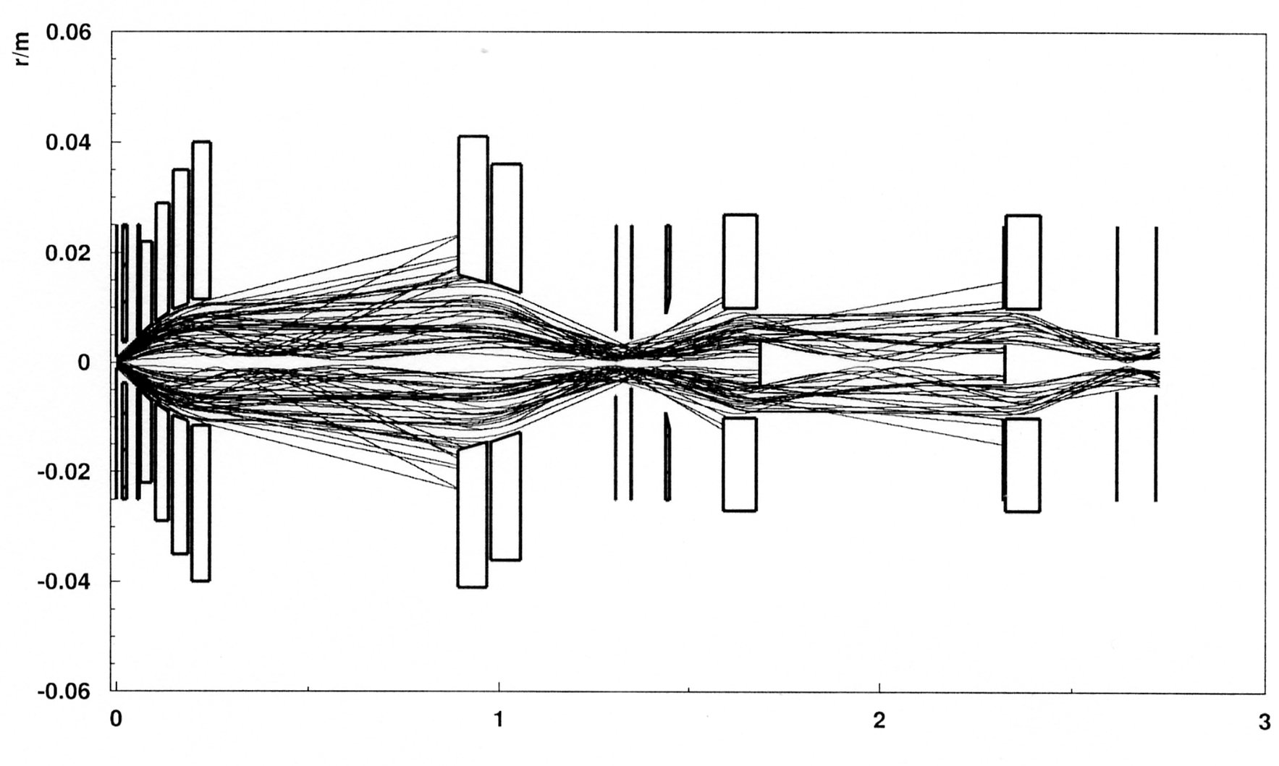
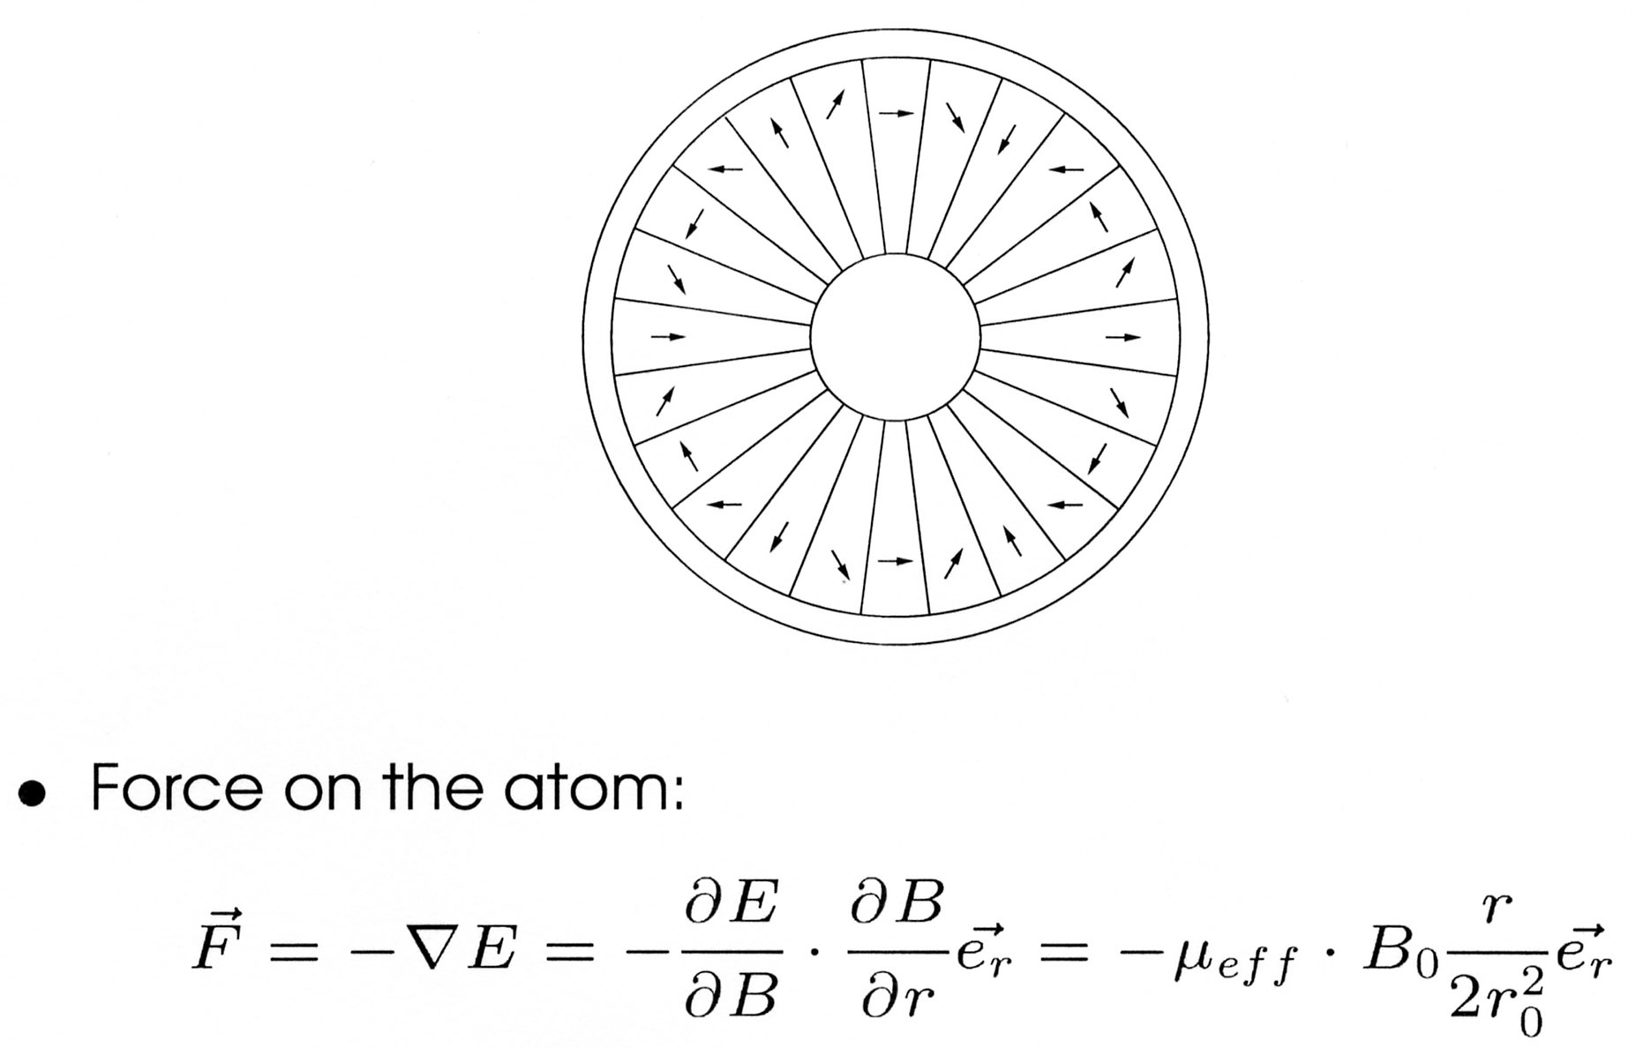
Spin filtering technique. Atomic beam sources
Hydrogen atoms with electron polarization: m_{J}=+1/2 trajectories
Breit-Rabi polarimeter
RHIC beam crossing
RF transition, polarization transfer
from electrons to protons
Magnet system design, NIM A256, (2006)
T.Wise, W.Haeberli, H.Kolster et al.
Ne-Fe-B permanent magnet
sextupole - 1.7 T
gradient 5.7 T/cm
Notes:
7

Slide 8
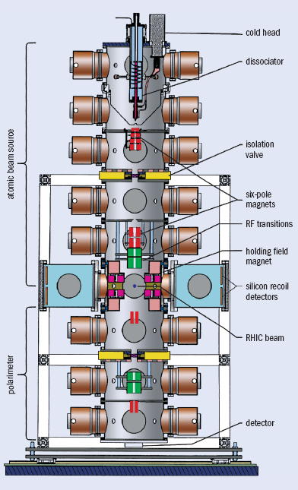
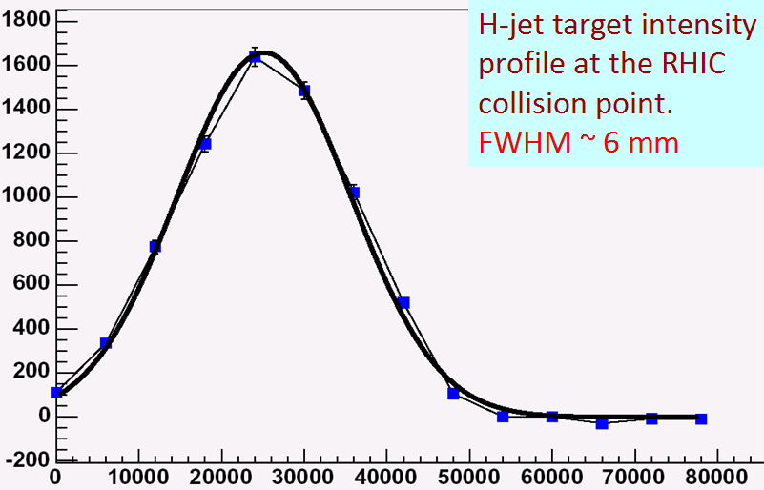
H -jet polarimeter
FWHM=5.5 mm
The distance from the nozzle
To collision point is 127 cm
Record 12.6∙10¹⁶ atoms/s
Atomic Beam intensity.
Atomic beam velocity ~ 1800 m/s
H-jet thickness at the collision point-1.2 ∙10¹² atoms /cm²
Notes:
8

Slide 9
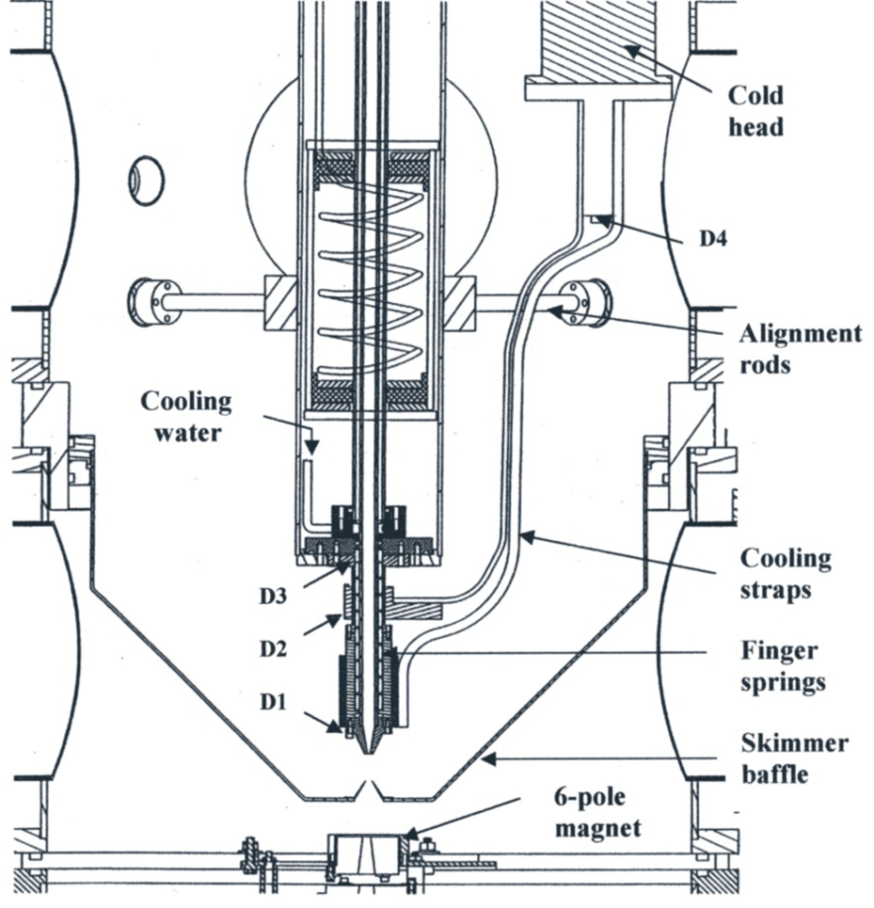
H - jet polarimeter.
Dissociator
Notes:
9

Slide 10
Scattering
Asymmetry due to spin-orbital interaction in nucleus.
Polarizer

Slide 11
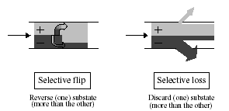
Antiproton polarization in the storage ring
Antiproton
beam
Selective loss in the polarized hydrogen storage cell.

Slide 12
Nearly resonant charge-exchange reactions which can be used for production of polarized ions. A.Belov
H⁰↑ + D⁺ ⇒ H⁺↑ + D ⁰
D⁰↑ + H⁺ ⇒ D⁺↑ + H⁰ σ ~ 5 10⁻¹⁵ cm²
H⁰↑ + D⁻ ⇒ H⁻↑ + D ⁰
D⁰↑ + H⁻ ⇒ D⁻↑ + H ⁰ σ ~ 10⁻¹⁴ cm²
³He⁰ ↑ + ⁴He⁺⁺ ⇒ ³He⁺⁺↑ + ⁴He ⁰ σ ~ 5⋅10⁻¹⁶ cm²
In order to produce polarized negative hydrogen ions it was necessary to have deuterium plasma consisting mainly from D⁺ and D⁻ ions because slow polarized H⁻ ions can be easily destroyed in collisions with plasma electrons
Plasma injector producing deuterium plasma enriched by D⁻ ions with surface-plasma converter has been developed at INR.

Slide 13
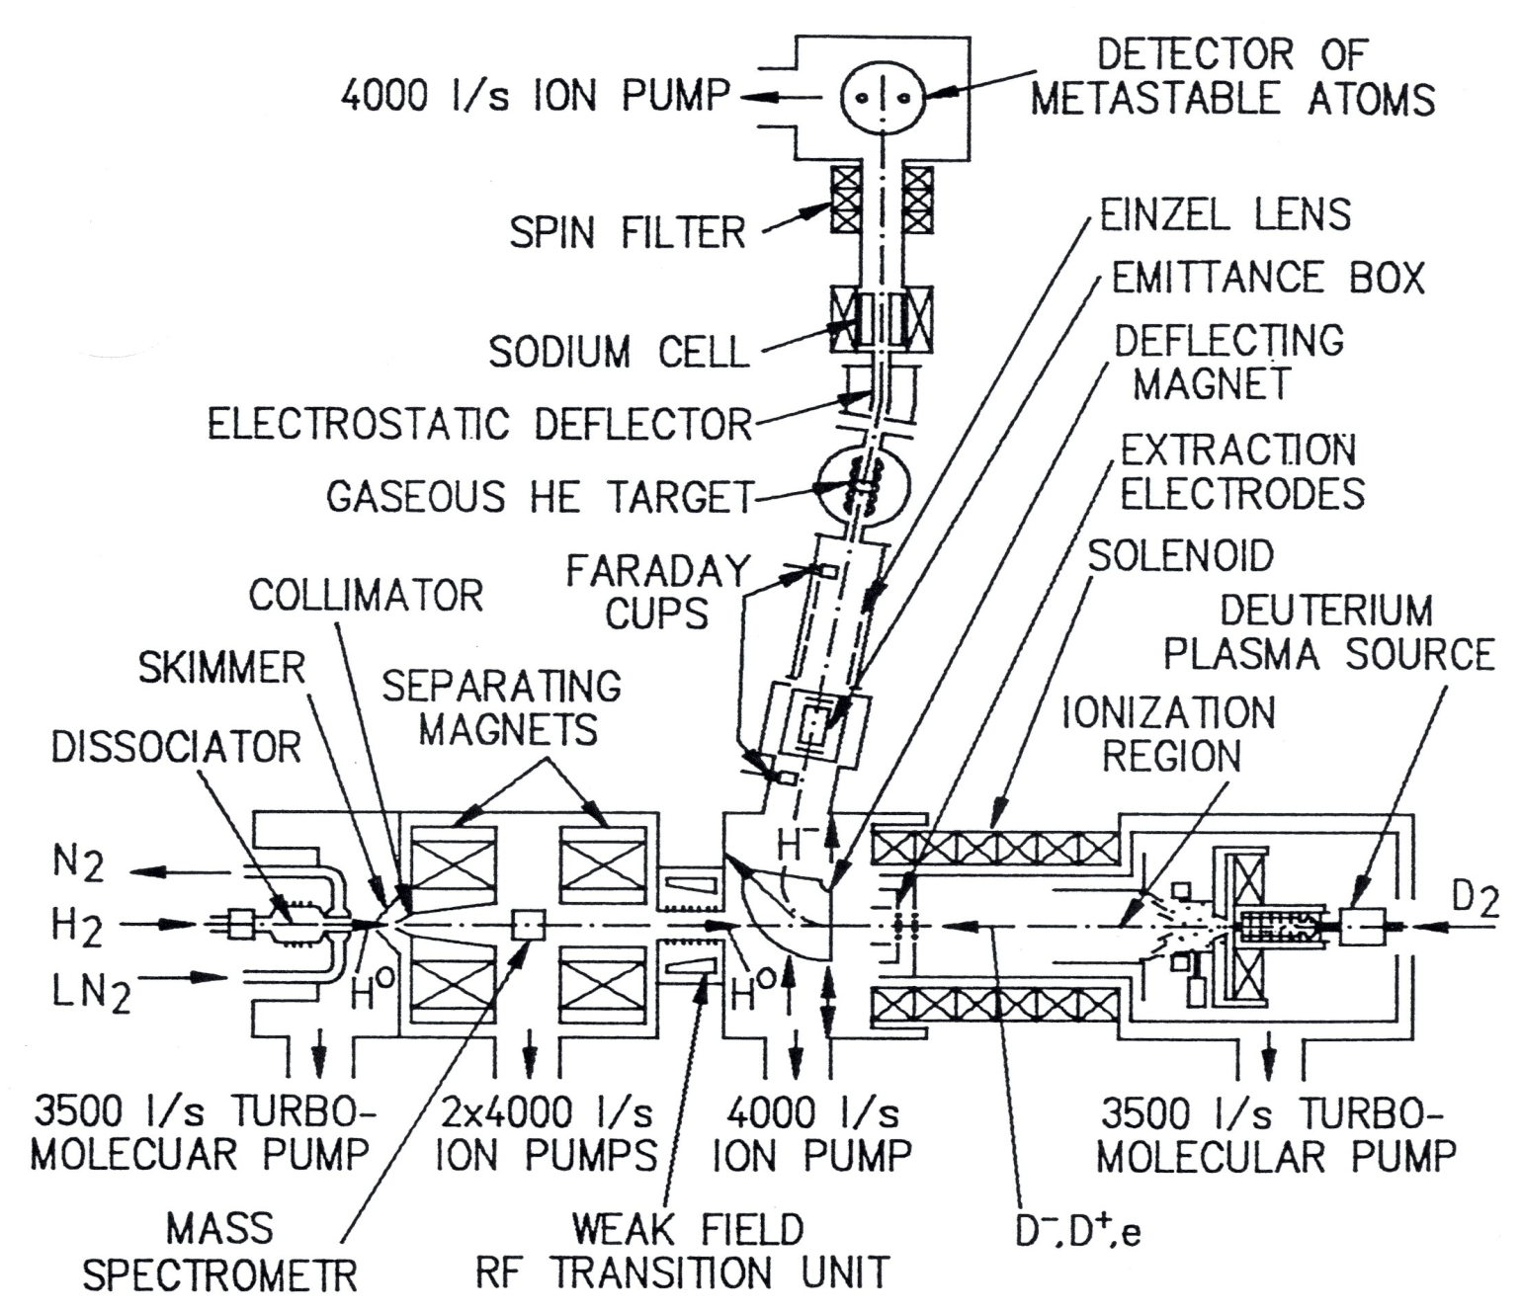
Polarized source of H-/D- and H+/D+ ions with nearly resonant charge-exchange plasma ionizer. INR Moscow

Slide 14
Plasma generator for resonant charge-exchange ionizer
D⁺, D⁻, e
In order to produce polarized negative hydrogen ions it was necessary to have deuterium plasma consisting mainly from D⁺ and D⁻ ions because slow polarized H⁻ ions can be easily destroyed in collisions with plasma electrons.
Plasma injector producing deuterium plasma enriched by D⁻ ions with
surface-plasma converter has been developed at INR.

Slide 15
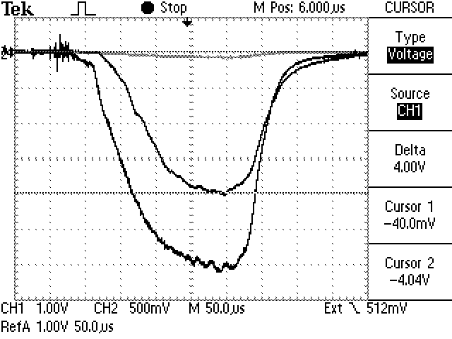
Oscillograms of polarized H⁻ ion current (vertical scale-1mA/div) and unpolarized D⁻ ion current (10mA/div)
Unpolarized D⁻ ion current, 60 mA
Peak H⁻ ion current 4 mA,
(3 mA-200us)
Polarization 85-90%
Normalized emittance 2 π mm mrad
Unpolarized D⁻ ion current 60 mA (~20 mA/cm²)
Pulse duration (FWHM) 170 μs
Rep. rate 5 Hz

Slide 16
COSY/Julich polarized H-/D- ion source
Cs⁺ (30 keV) + Cs => Cs⁰
H⁰↑ + Cs⁰ ⇒ H⁻↑ + Cs ⁺
D⁰↑ + Cs⁰ ⇒ D⁻↑ + Cs ⁺
Polarized beam current
up to 50 μA
Pulse duration is 10 ms (injector - cyclotron)
Polarizaton of beam injected into COSY ring,
up to 91,4 % !
R. Gebel - PSTP2007
30 keV

Slide 17
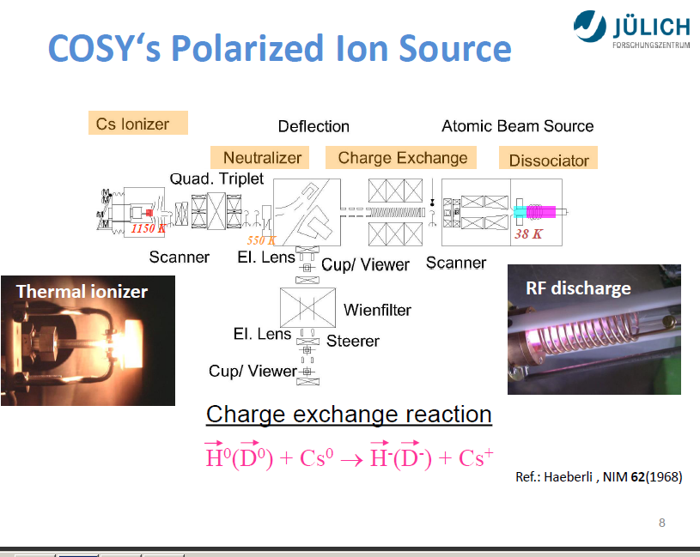
R.Gebel

Slide 18
Polarized deuteron source for Dubna NUCLOTRON accelerator
    New source with nearly resonant charge-exchange ionizer is developed
    Project goal:
      10 mA D⁺ (Н⁺)
      polarization ~ 90 % from nominal vector polarization + (-) 1 and tensor polarization + 1,-2
    Parts of CIPIOS source from IUCF will be used.
    Collaboration between JINR (Dubna) and INR Moscow.
    Storage cell is planned to be used to reduce background current of H₂⁺ ions

Slide 19
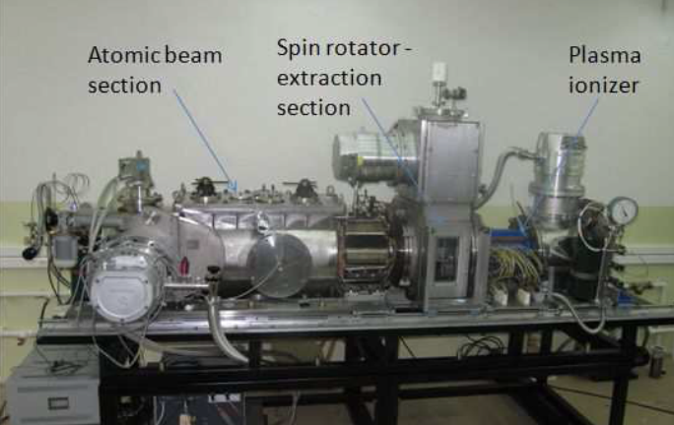
The polarized ions source for the JINR accelerator complex
The project assumes the design and construction of a universal high-intensity source of polarized deuterons (protons) using a charge-exchange plasma ionizer. The output D+↑(H+↑) current of the source is expected to be at a level of 10mA. The polarization will be up to 90% of the maximal vector (±1) for D+↑ (H+↑) and tensor (+1, -2) for D+↑ polarization. Realization of the project is carried out in close cooperation with INR of the RAS (Moscow).

Slide 20
Depopulation optical pumping
5P_{1/2}
λ = 795 nm
Circularly Polarized light
1.56 eV
Spontaneous
decays.
nL_{J}
5S_{1/2}
M_{J} = -1/2
relaxation
M_{J} = +1/2
~ 100% polarized Rb atoms!
Optical pumping application is limited by available laser wavelenghes!?
Recent progress in laser technology is very promising for new applications.
W. Happer, Rev. Mod. Phys. 44, 170 (1972)
Notes:
Need to add info about N2 admixture, and the relaxation transitions it causes

Slide 21
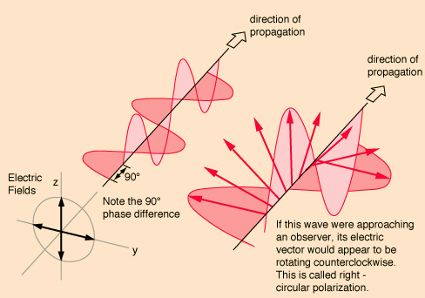
Polarized light
We will see world differently
in polarized light.
Linear
polarization
Circular
polarization

Slide 22
The light can be polarized by scattering: filtering, reflection, refraction.
The circular polarized light transfer an angular momentum, which can be used for electron and nuclei polarization in atoms.
Laser beams are always polarized.
Laser beam is a powerful source of angular momentum:
10 W (795 nm) → 4•10¹⁹ photons/sec

Slide 23
Optical pumping of alkali metals
Li 671 nm
Na 590
Valence electron absorbs light g tranfers polarization to nucleus via hyperfine coupling
K 770
Rb 795
Cs 894
Typical polarization = 60 – 70%
Fr 817
m_{F}
-5/2 -3/2 -1/2 1/2 3/2 5/2
F =5/2
3/2
²P_{1/2}
+
σ
⁸Li
I
= 2
5/2
381 MHz
²S_{1/2}
3/2

Slide 24
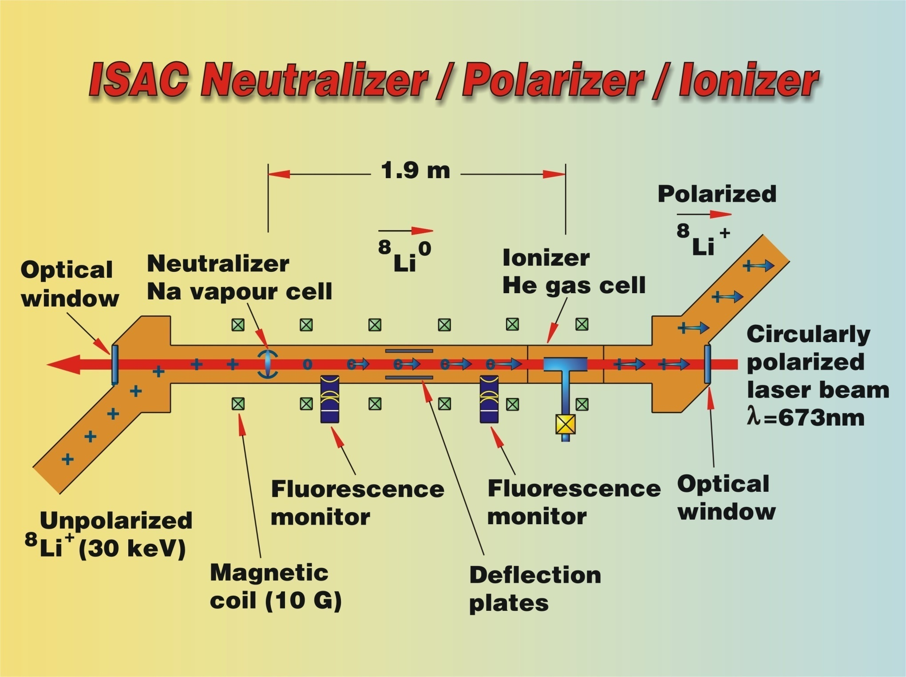
Collinear Optical Pumping polarizer at TRIUMF
Notes:
Contrast with ISOLDE

Slide 25
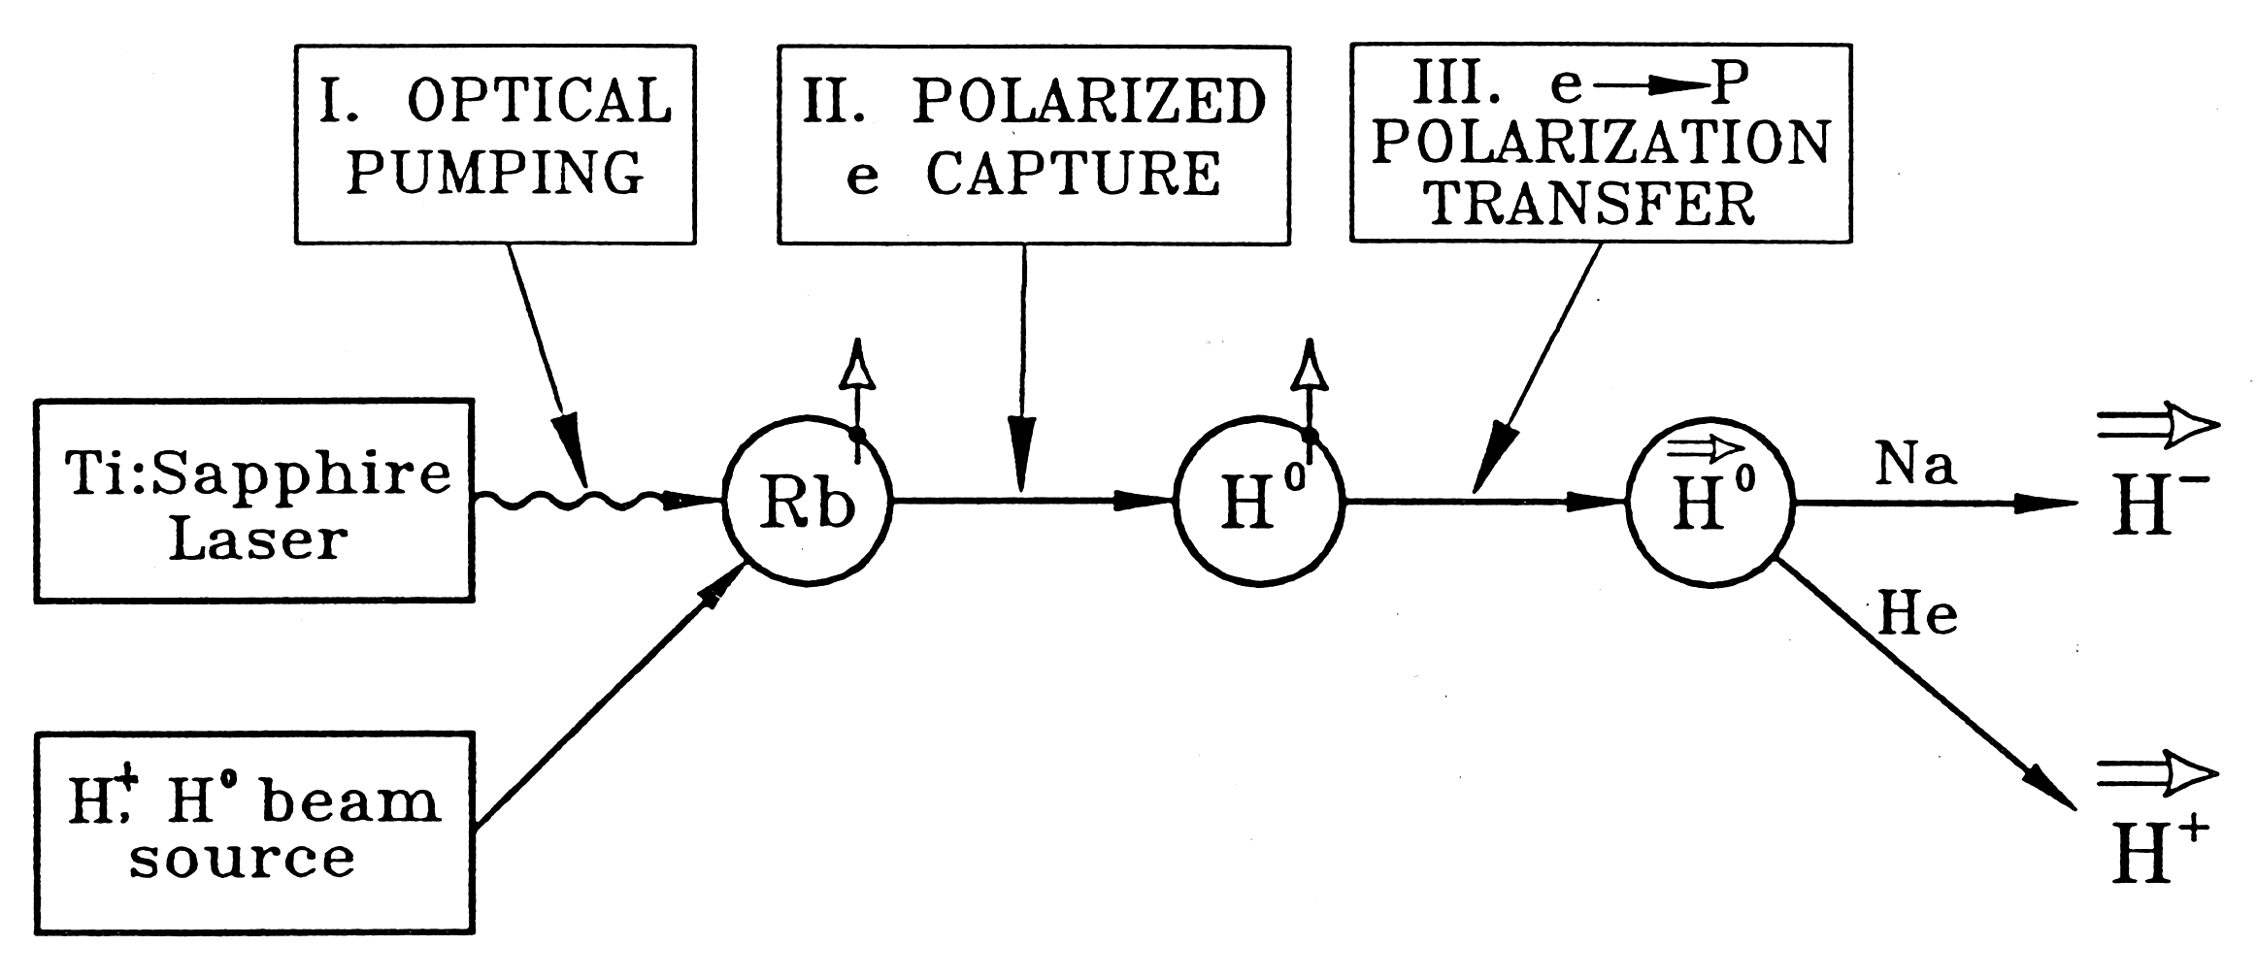
Electron polarization transfer in charge-excgange, or spin-exchange collisions.
Electron polarization transfer in charge-exchange collisions:
(H⁺ + Rb⇑ → H⁰ ⇑ + Rb⁺) ~ 10⁻¹⁴ cm²
or
Electron polarization transfer in spin-exchange collisions:
σ (H⁰ + Rb⇑ → H⁰ ⇑ + Rb) ~ 2 ·10⁻¹⁵ cm²

Slide 26
Spin-transfer polarization in proton-Rb collisions
Laser-795 nm
Optical pumping
Rb: NL(Rb) ~10¹⁴ cm⁻²
Na-jet ionizer cell:
NL(Na)~ 3•10¹⁵ cm⁻²
Rb⁺
Rb⁺
Proton
source
H⁺
H⁺
Sona
transition
Ionizer
cell
H⁻
1.5 kG field
ECR-29 GHz
Н⁺ source
~50 mA, 2.8keV
Supperconducting solenoid 25 кГс
Charge-exchange collisions:σ ~10⁻¹⁴ cm²
Electron to proton polarization transfer
Laser beam is a primary source of angular momentum:
10 W (795 nm) 4•10¹⁹ hν/sec 2 A, H⁰ equivalent intensity.
Notes:
26

Slide 27
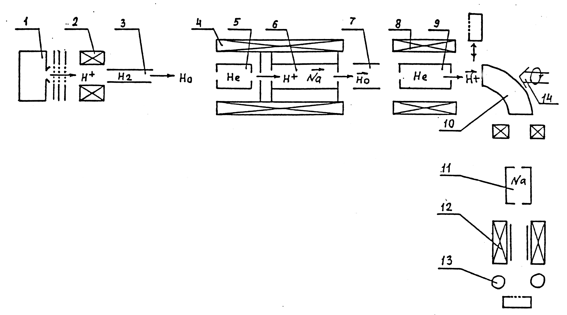
Pulsed OPPIS with the atomic hydrogen injector at
INR, Moscow, 1982-1990. First generation.
Atomic H injector
Helium ionizer cell
~80% ionization
efficiency.
H⁻ current 0.4mA, P=65%
Lamb-shift polarimeter

Slide 28
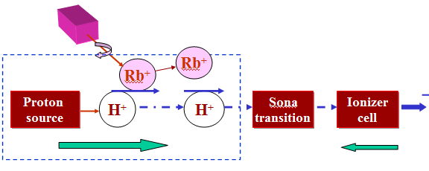
OPPIS with atomic H⁰ injector
High-brightness proton beam inside strong 2.5 T solenoid field
produced by atomic H beam ionization in the He-gas ionizer cell
H⁻
H0
Atomic H
injector
He-cell
25 kG
1.5 kG
The primary proton beam and
Equivalent atomic H intensity
current is 2.5 A at 6.5 keV beam energy !

Slide 29
Pulsed OPPIS with the atomic hydrogen injector at
INR, Moscow, 1982-1990. First generation.
Atomic H injector
Helium ionizer cell
~80% ionization
efficiency.
H⁻ current 0.4mA, P=65%
Lamb-shift polarimeter

Slide 30
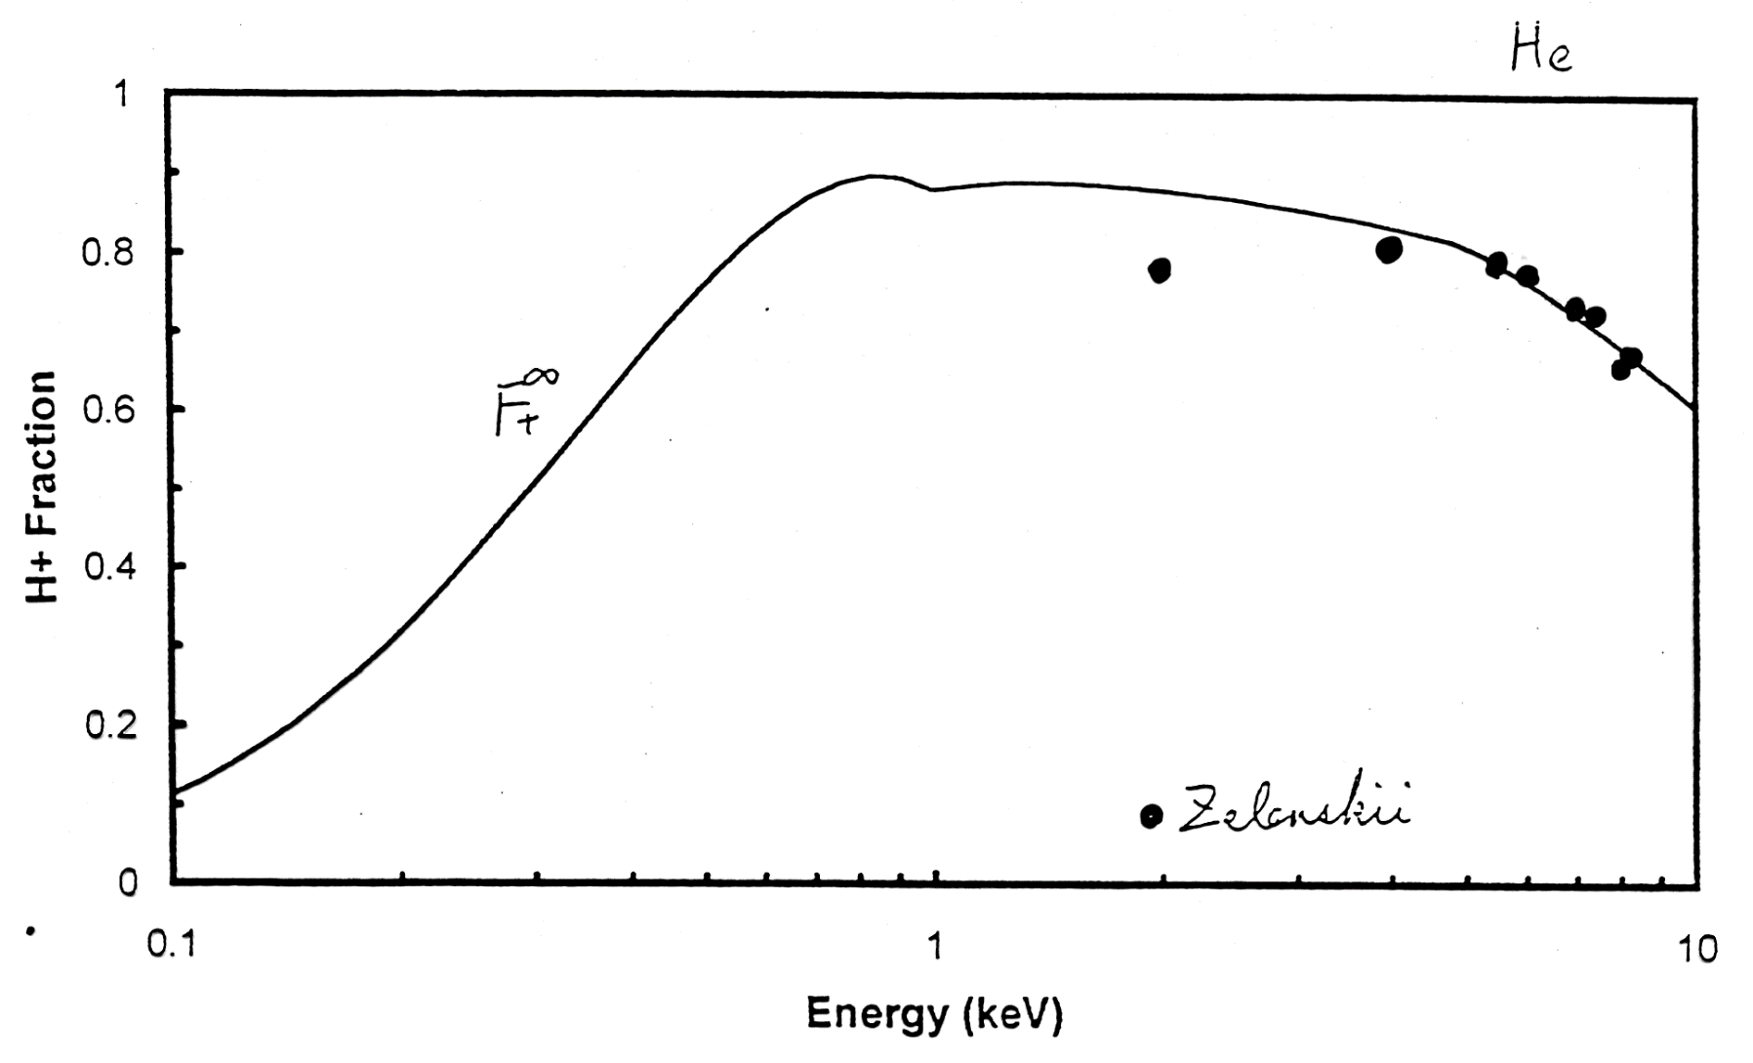
Atomic H⁰ ionization efficiency in the He cell
H⁰ + He → H⁺ + He + e
80%
10 keV

Slide 31
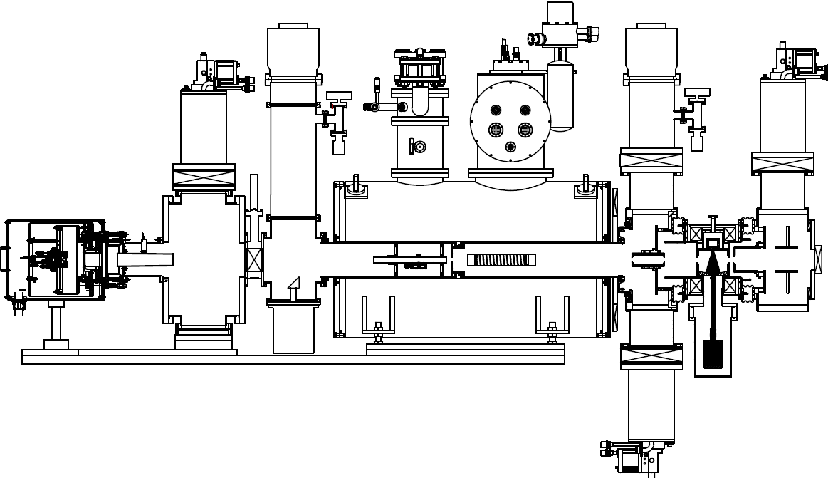
OPPIS with atomic H⁰ injector and He-ionizer cell at RHIC, 2012-19
TMP1
CP1
Neutralizer
H₂-cell
He-ionizer
cell
Sona
transition
Na-jet
cell
Atomic H
injector
Rb-cell
H⁰
H⁺
H⁰
H⁻
H⁺
H2
He
Rb
Na

Slide 32
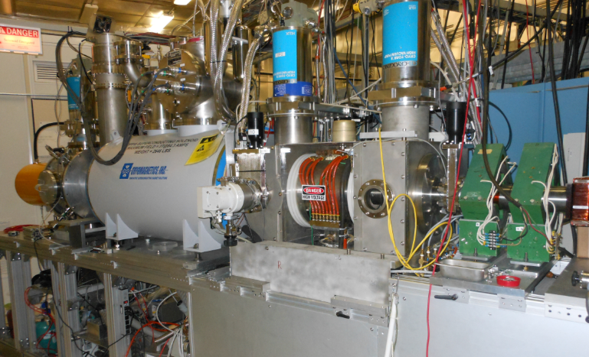
The RHIC OPPIS with atomic hydrogen injector, Run-2013
BNL, BINP, Novosibisk, INR, Moscow- collaboration

Slide 33
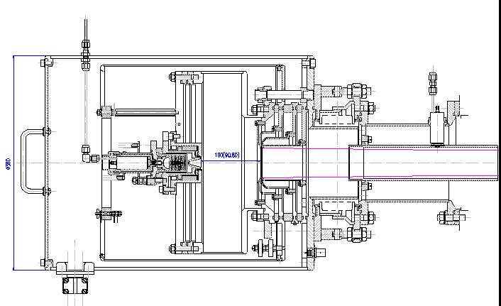
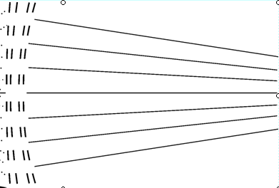
“Fast Atomic Beam Source”, FABS, BINP, Novosibirsk,2011
Plasmatron
4-grid proton
extraction system
~ 2.5 A
equivalent
H⁰ beam
H2 Neutralization cell
FABS produces 100-150 mA equivalent H0 beam intensity
Within the Na-jet ionizer acceptance.

Slide 34
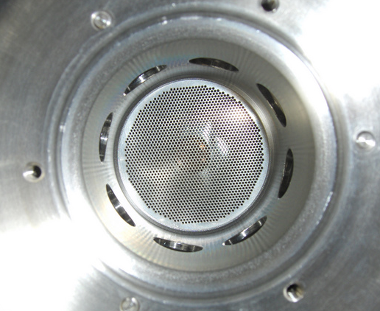
FABS 4-grid (spherical) Ion Optical System
with “geometrical focusing
2.5-5.0 A of
proton beam
At 6-10 keV
energy
1820 holes ,
1.0 mm in diameter
R1, grid1-180 cm
R2, grid2-150 cm
R3, grid3-120 cm
R4, grid4-120cm
5.0 cm

Slide 35
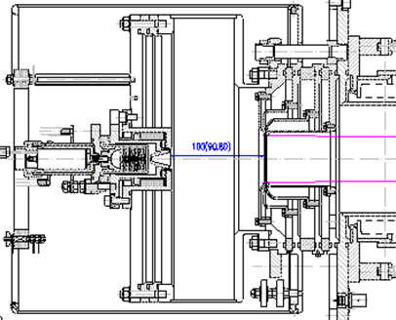
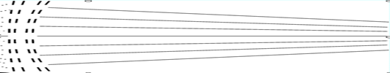
Atomic H beam profile measurements vs. distance from the source
High-brightness
Proton source
Bending
magnet
Deflecting
magnet
FC
H⁻
SEM
200 cm
H⁺
H2-neutralizer
cell
Movable CEM beam
Profile monitor

Slide 36
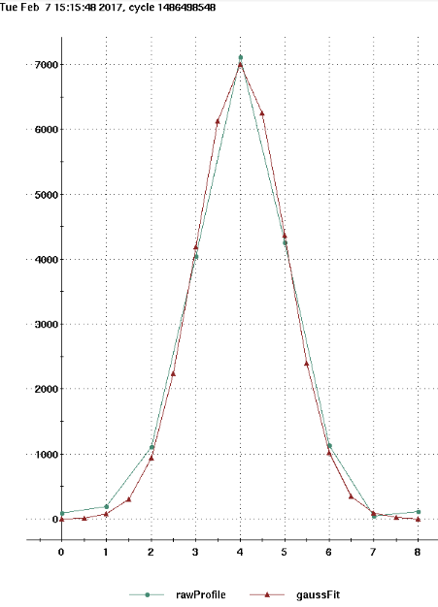
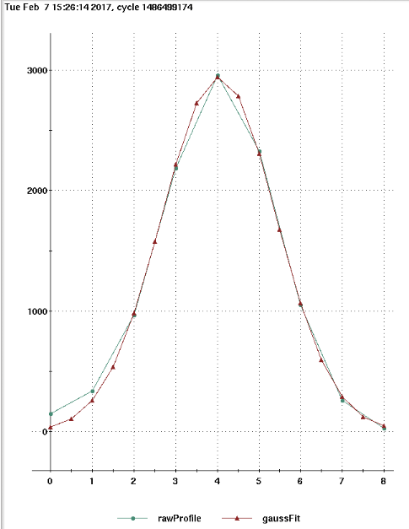
Atomic beam intensity profile vs. distance from the source.
Re-1.40 cm at the distance:
L=100 cm-from the source
Re-1.98 cm at the distance:
L=200 cm-from the source
FWHM-3.25 cm
FWHM-2.3 cm

Slide 37
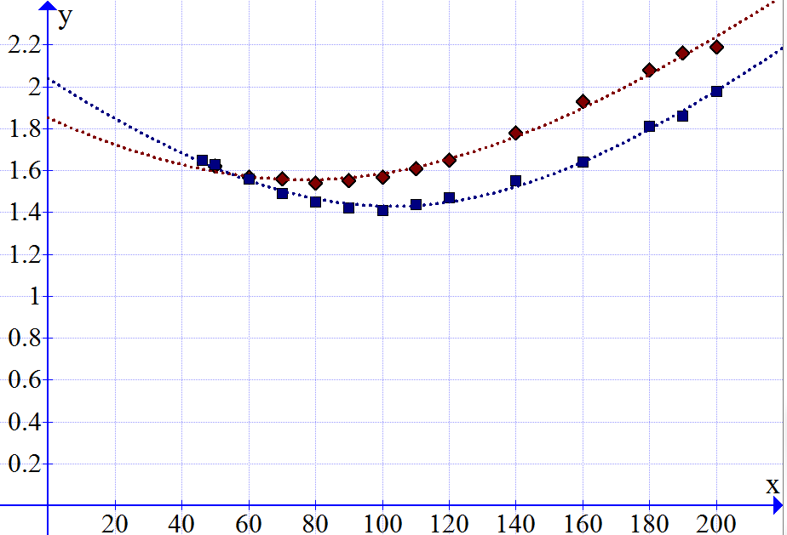
Atomic beam intensity profile vs. distance from the source measured with the movable secondary emission monitor
Total equivalent H beam intensity 2.5A
Re
IOS#1
New IOS#2
~300 mA/cm2
Distance from the source: L-cm
Re- half-width of beam intensity profile at -1/e level.
Beam profile FWHM = 1.67 Re

Slide 38
Residual un-polarized H0 beam component suppression
by energy separation
H⁰ + He → H⁺ + He + e
Deceleration
H⁰(6.5 keV)
Rb -cell
He-ionizer cell
H⁺(70%)
H⁰(2.5 keV)
H⁰(30%)
H⁰(6.5keV)
-4.1 kV
-4.0 kV
-4.1 kV
-2-3 kV
+0.1kV

Slide 39
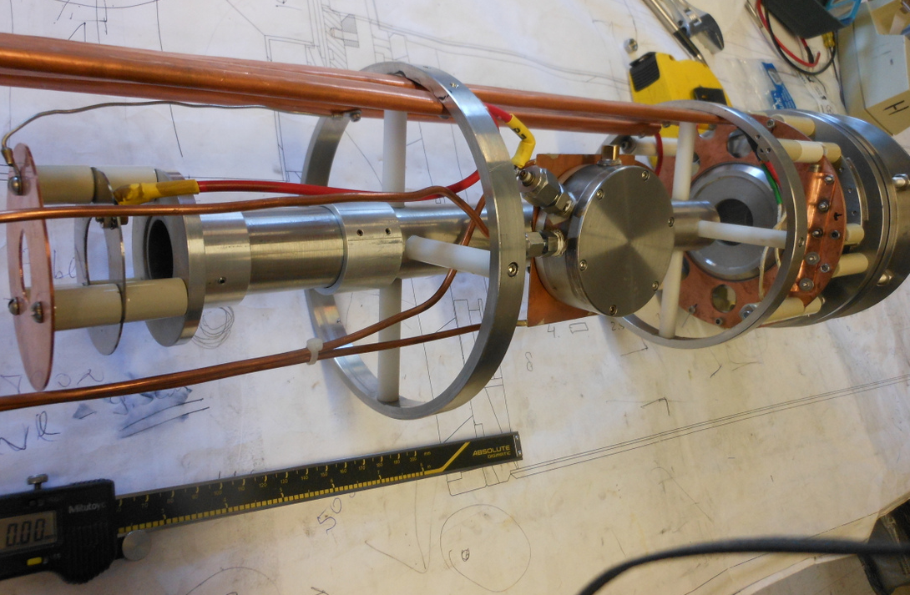
He-ionizer cell and 3-grid energy separation system
He-pulsed
valve
3-grid beam
deceleration
system

Slide 40
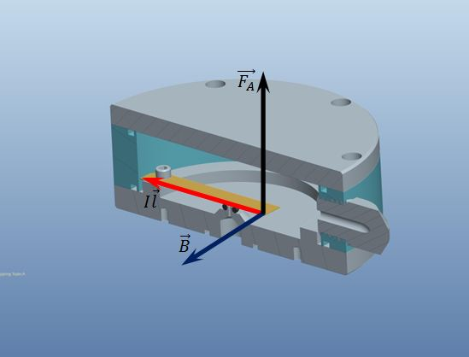
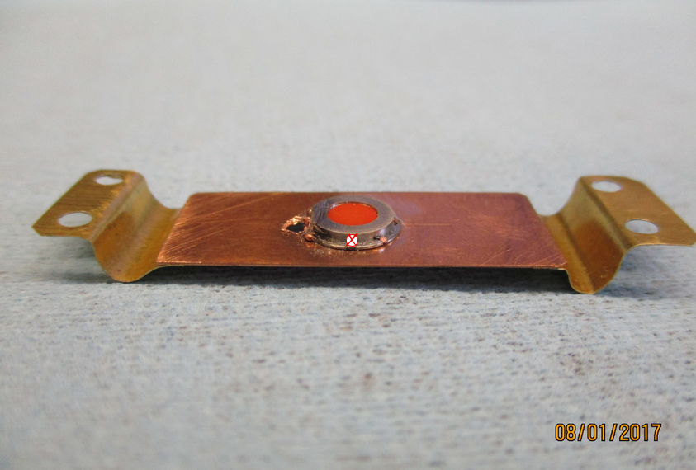
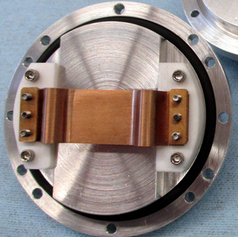
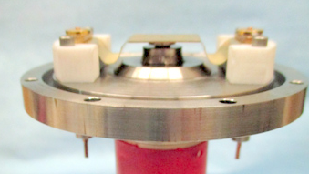
IxB-pulsed valve operation principle
Lorentz (Laplace) force moves the flexible conducting plate in the high (~ 3-5 T) magnetic field.
For I=10 A, L=5 cm, F=2.5 N. Current pulse duration ~100-500 us
F
I
B
I
B

Slide 41
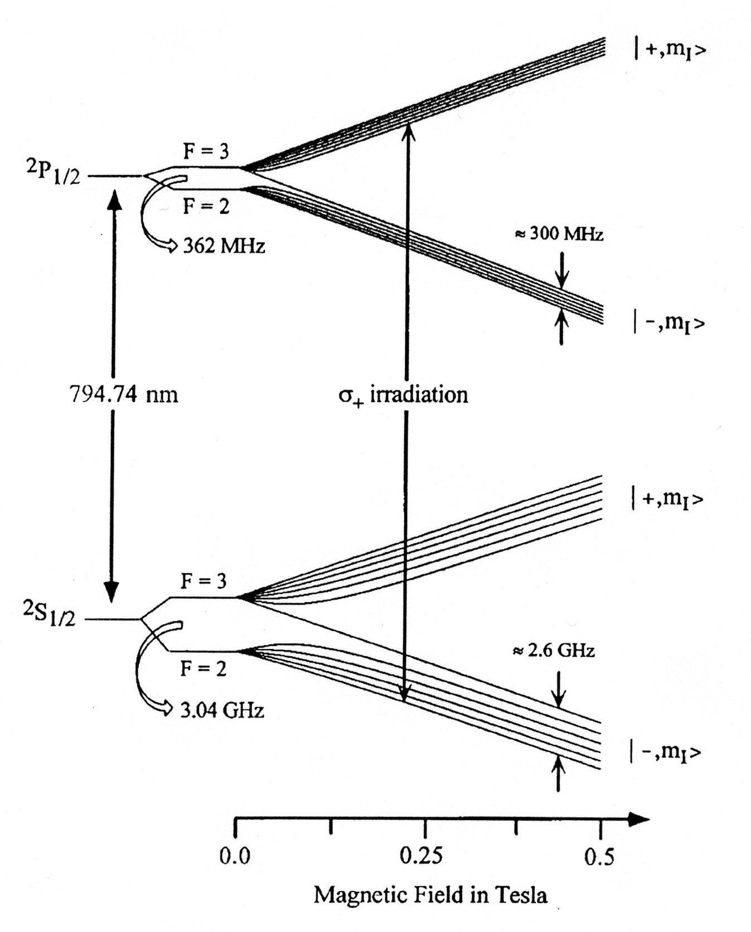
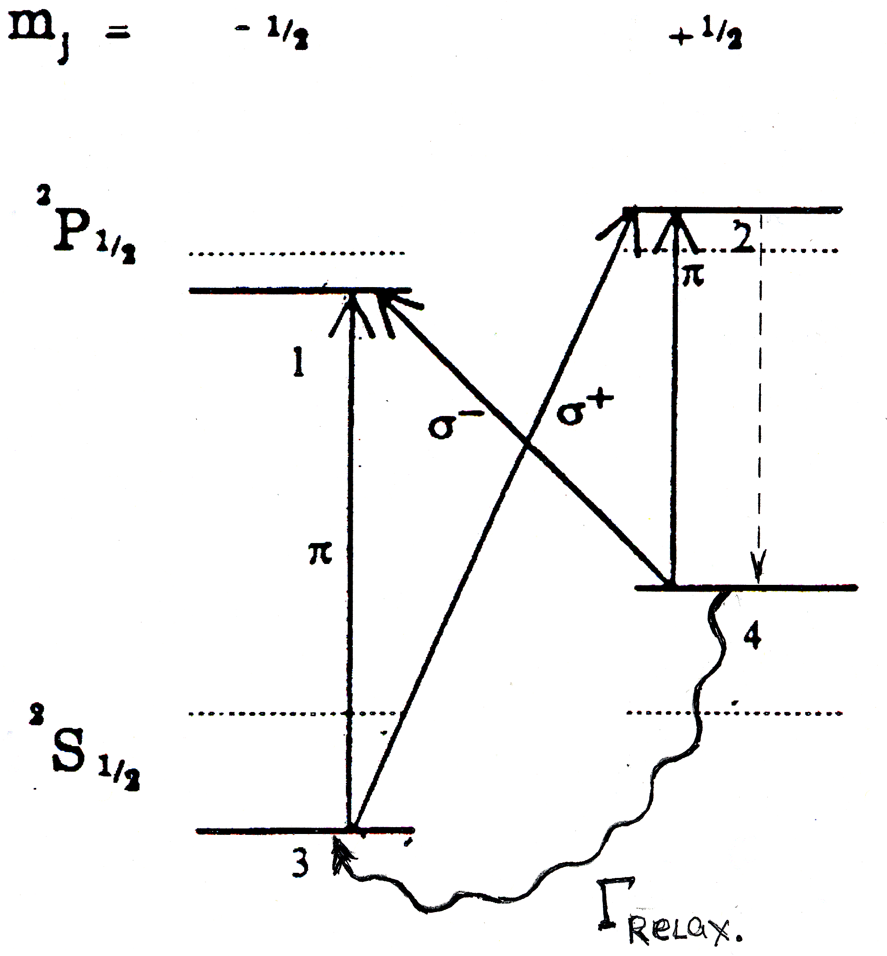
Optical pumping of Rb vapor, 784.7 nm pulsed Cr:LISAF laser
m_{J} -1/2 +1/2
28 mm
Rb vapor cell.
Rb pol.
Profile.
Rb
hν
Proton beam.
Optical pumping by σ+: Δm_{J}=1
Spontaneous radiation: Δm_{J}=0, 1.

Slide 42
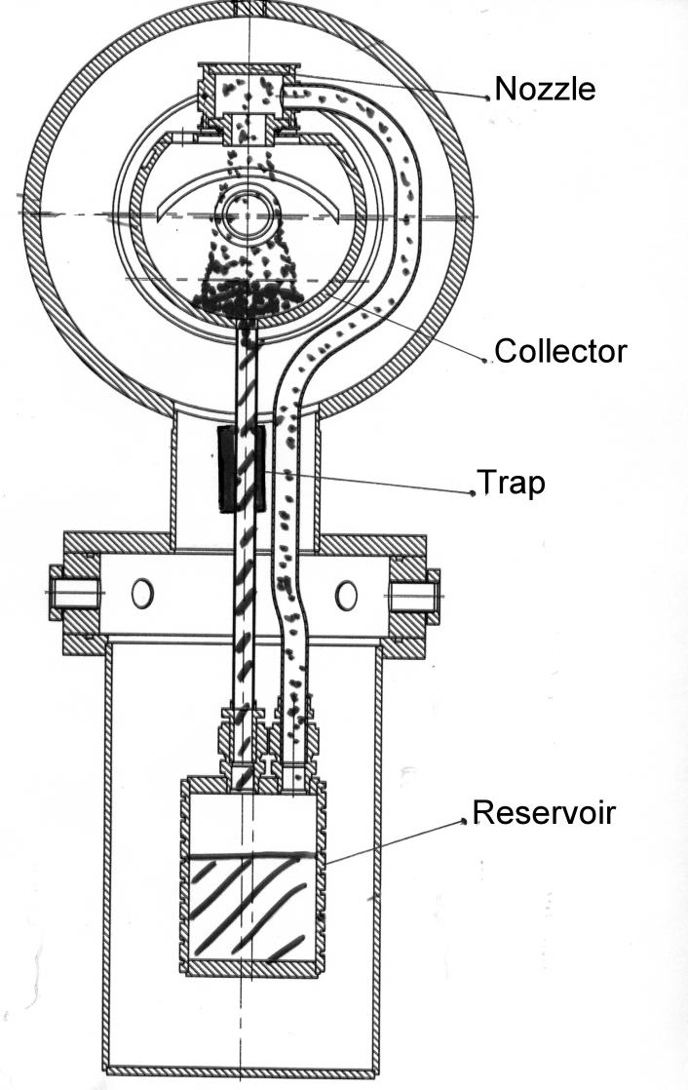
Sodium-jet ionizer cell
Transversal vapor flow in the Na-jet cell.
Reduces sodium vapor losses for 3-4 orders
of magnitude, which allow the cell aperture
increase up to 3.0 cm .
Nozzle
500deg.C
NL ~2·10¹⁵ at/cm²
L ~ 2-3 cm
Collector
~150 deg.C
Return
line
Boiler
~500 deg.C
Notes:
42

Slide 43
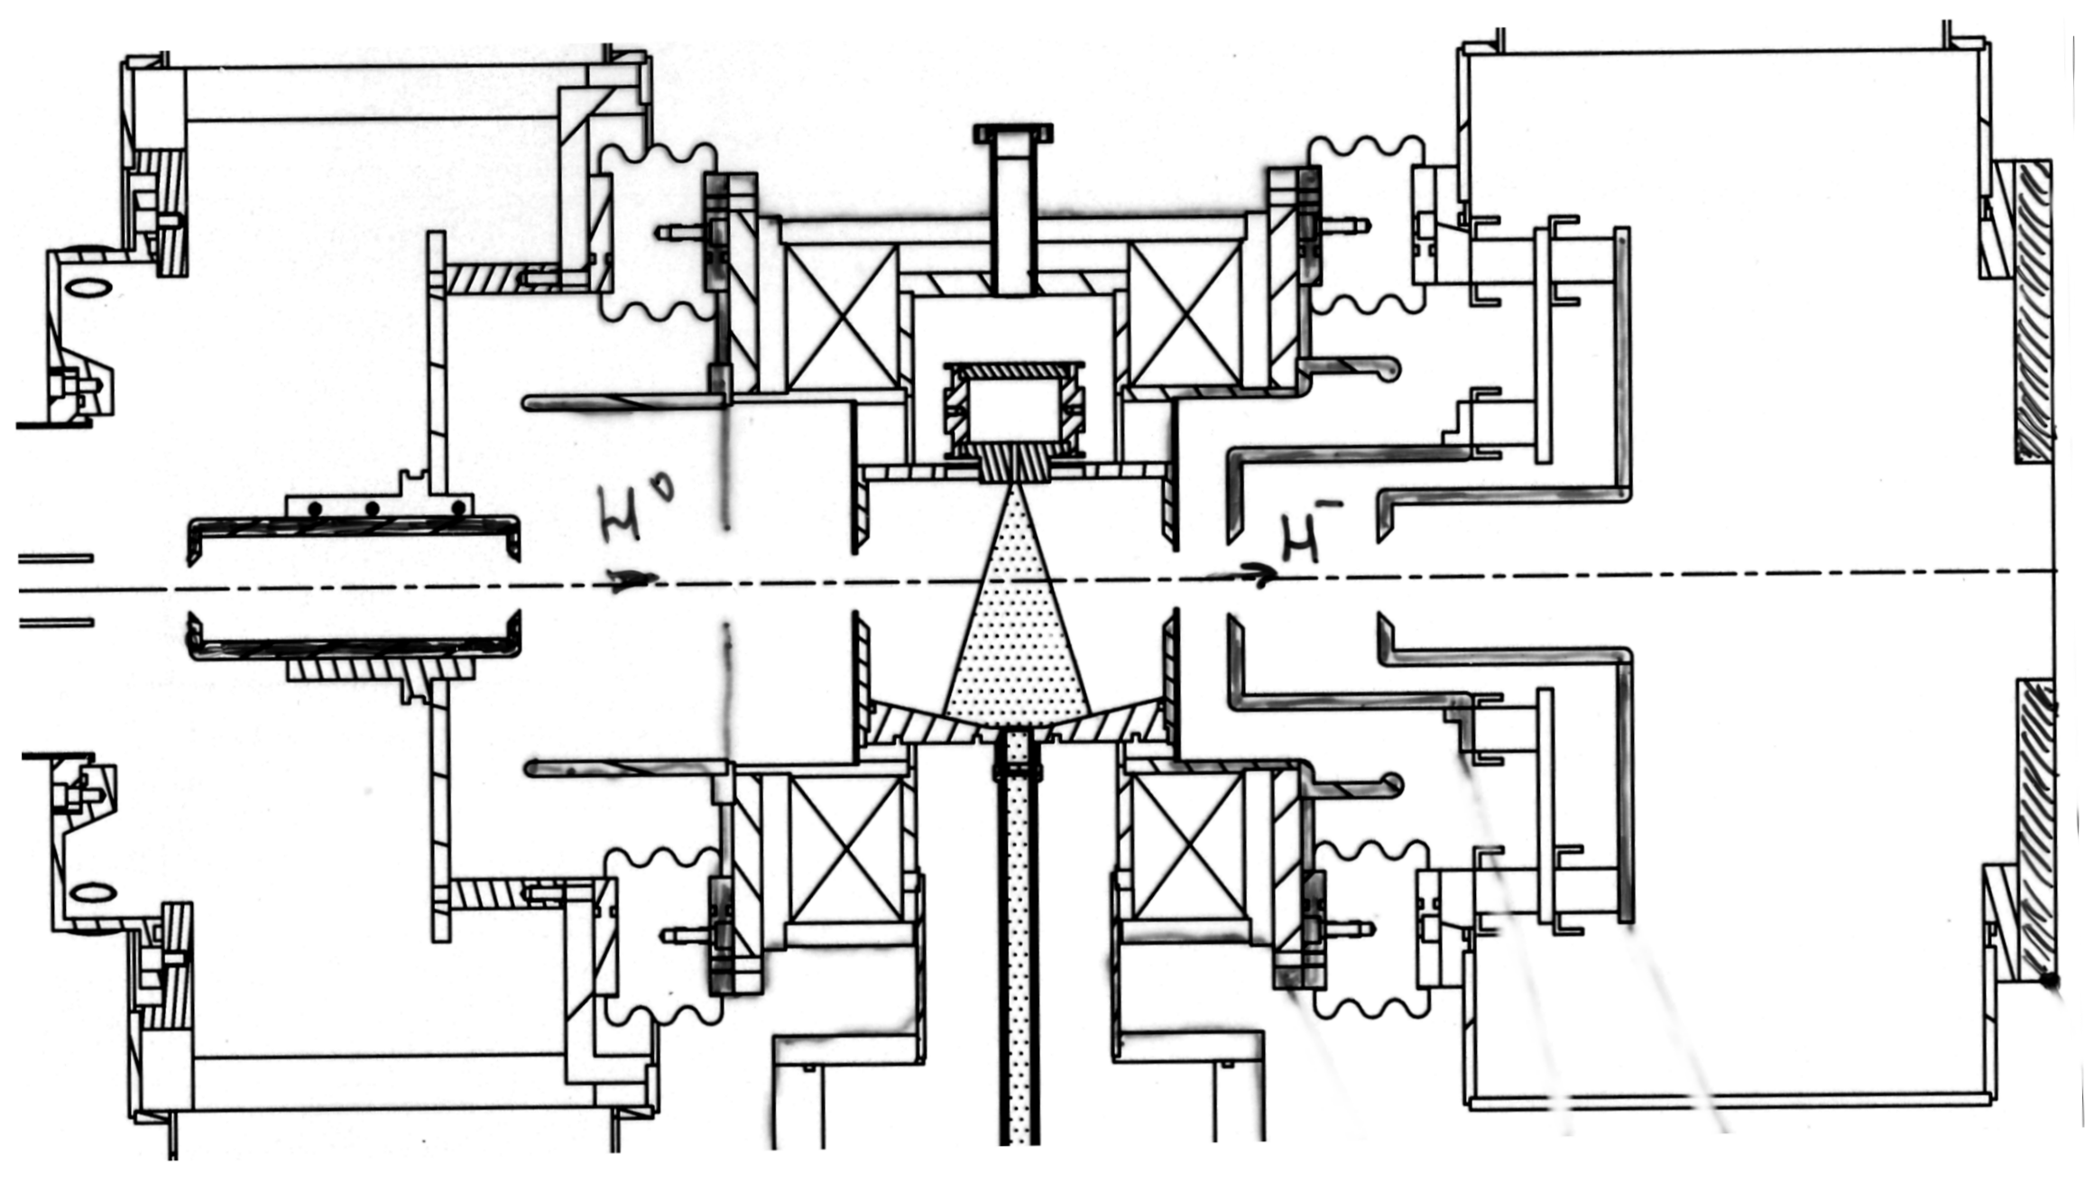
H⁻ beam acceleration to 35 keV at the exit
of Na-jet ionizer cell
H⁻
35 keV
39 keV
H⁰
3 keV
7 kev
-32 kV
-28 keV
-15 keV
Na-jet cell is isolated and biased to – 32 keV. The H⁻ beam is accelerated in a two-stage acceleration system

Slide 44
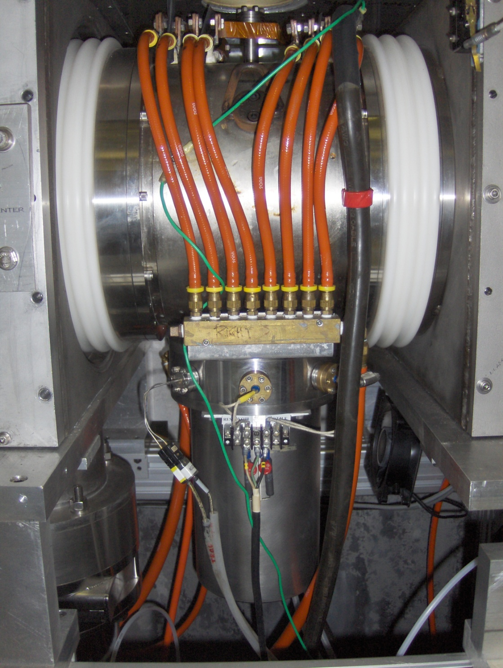
H⁻ beam acceleration to 35 keV at the exit of Na-jet ionizer cell.
H⁻
35 keV
-32 kV
-28 keV
-15 keV
Na-jet cell is isolated and biased to – 32 keV. The H⁻ beam is accelerated in a two-stage acceleration system.

Slide 45
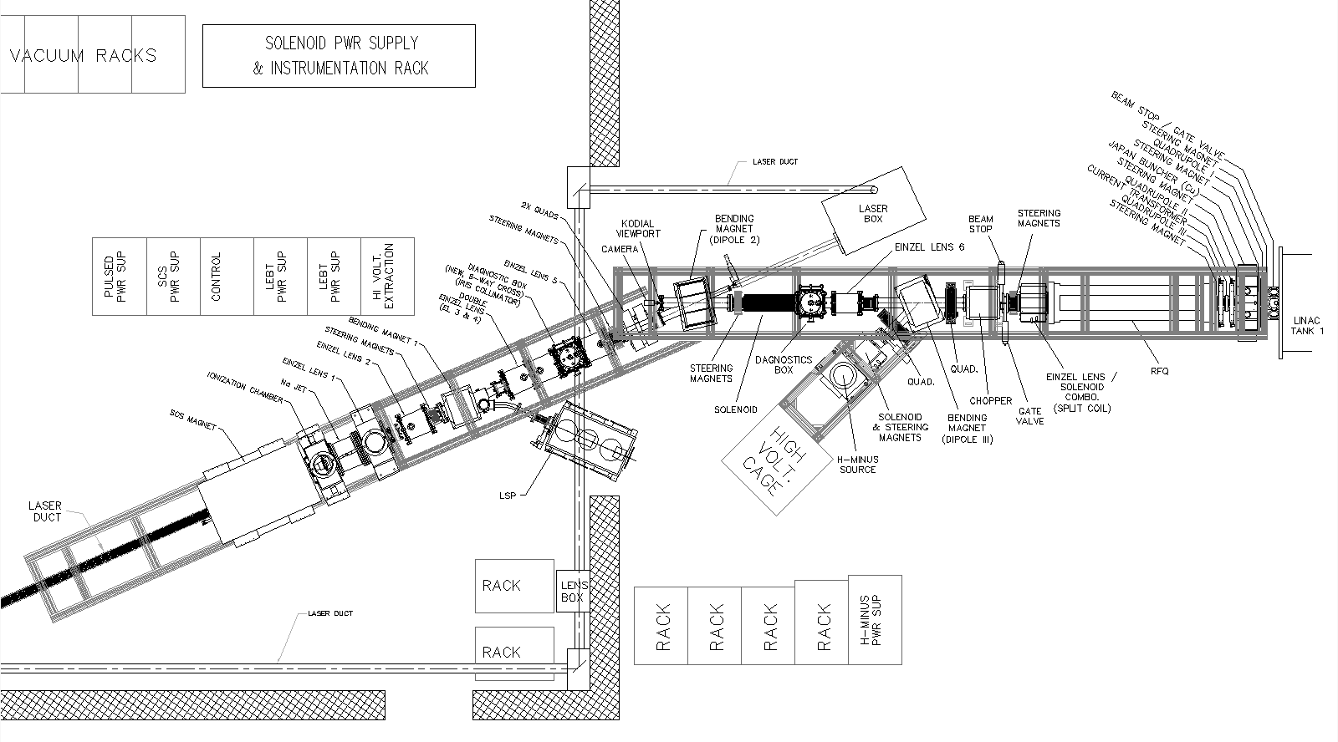
Low Energy Beam Transport line
Variable collimator
In DB2 to improve
Energy resolution.
23.7 deg bender
RFQ
OPPIS
FC4
35.0 keV
FC-Tk1,
750keV
Lamb Shift
Polarimeter
Notes:
45

Slide 46
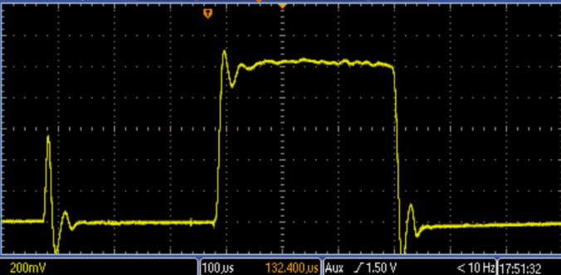
H⁻ ion beam current accelerated to 200 MeV, June-2017
1.05 mA
Rb-cell
Temp.-105 deg.
300 us

Slide 47
Beam intensity and polarization at 200 MeV
Reliable long-term ∙operation of the source was demonstrated.
Very high suppression of un-polarized beam component was demonstrated.
Small beam emittance (after collimation for energy separation) and high transmission to 200 MeV.
Rb-cell thickness-NL X 10¹³ atoms/cm² | 4.5 | 5.5 | 7.5 | 10.4
Linac Current, μA | 440 | 520 | 740 | 1050
Booster Input ×10¹¹ H⁻/pulse | 10.0 | 12.0 | 14.0 | 17.1
Pol. %, at 200 MeV | 86 | 86 | 84.5 | 83

Slide 48
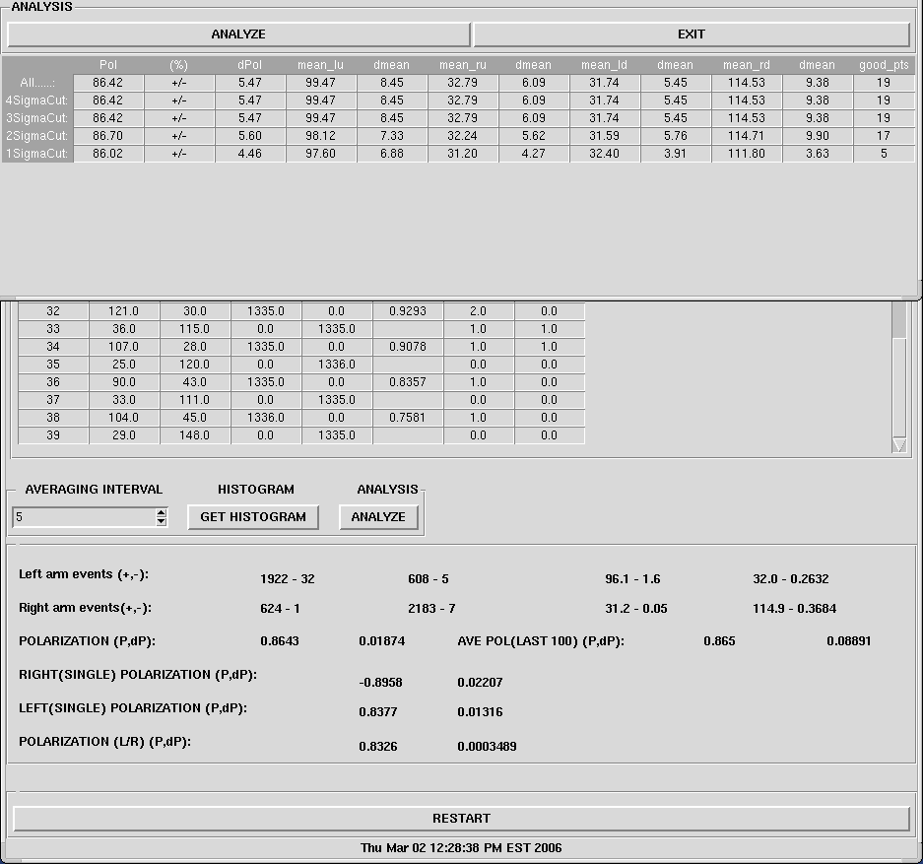
Polarization measurement in 200 MeV polarimeter.
86.7%
200 μA× 400 μs pulse at 200 MeV
~ 4.8∙10¹¹ H⁻/pulse
86.4%

Slide 49
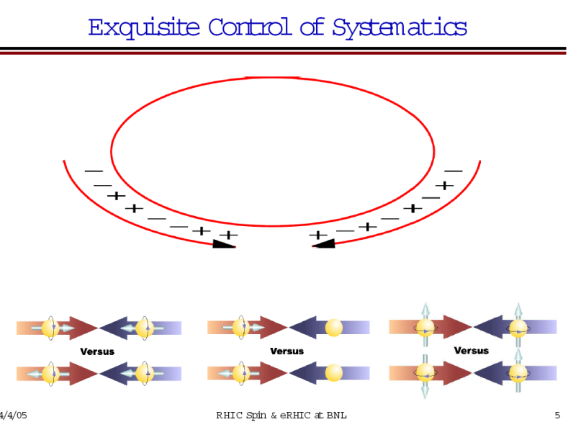
RHIC Polarized beam in Run 2013-17
OPPIS
1.0 mA x 300us→18∙10¹¹ polarized H⁻ /pulse
9.0 ∙10¹¹ polarized H⁻ /pulse at 200 MeV
routinely in Run-17, Polarization-85%
LINAC
Booster
(2.5-3.0) ∙10¹¹ protons /pulse at 2.3 GeV
AGS
(2.0-2.5) ∙10¹¹ p/bunch, P-70%
~1.8∙10¹¹ p/bunch, P~65-75% at 100 GeV
P ~ 60-65% at 255 GeV
RHIC
Notes:
49
49

Slide 50
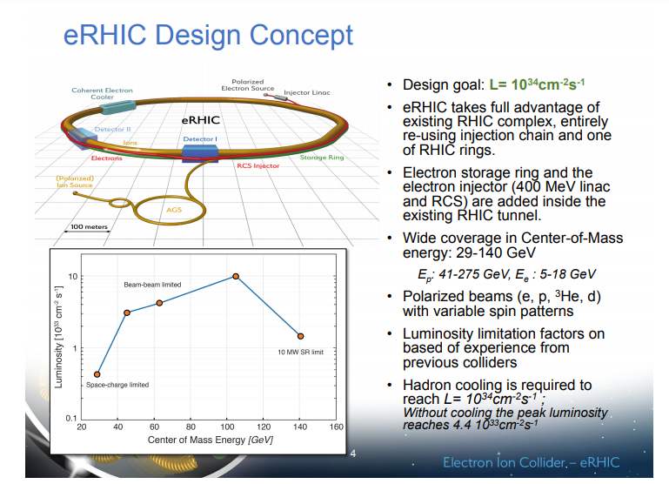

Slide 51
Production of polarized ³He⁺⁺ beam in EBIS. A.Zelenski, J.Alessi, ICFA Beam Dynamics
Newsletter 30, p.39, (2003)
Existed 3He++ sources intensity- 50nA, Birmingham
³He polarization inside the EBIS in high (5.0T) magnetic field. No polarization losses during beam transport through gradient magnetic field.
EBIS is used for efficient ionization and accumulation of polarized 3He⁺⁺ ions to the full capacity 10¹² total charge (5∙10¹¹ , 3He⁺⁺ ions).
Notes:
51

Slide 52
Principle of EBIS Operation
10A, 10-20 keV
Radial trapping of ions by the space charge of the electron beam.
Axial trapping by applied electrostatic potentials at ends of trap.
The total charge of ions extracted per pulse is ~ (0.5 – 0.8) x ( number electrons in the trap ~1.0∙10¹² )
Ion output per pulse is proportional to the trap length and electron current.
Ion charge state increases with increasing confinement time.
Output current pulse is independent of species or charge state!
Notes:
52

Slide 53
“Extended” EBIS upgrade with new “injector” solenoid for polarized 3He⁺⁺ ion production
Polarization and ionization in high magnetic field
will produce 3He⁺⁺ ion beam with P ≥ 80%
Optically-pumped 3He cell
Ionization to 3He⁺⁺
Up to 2×10¹¹ 3He⁺⁺ ions/pulse
3He⁺

Slide 54
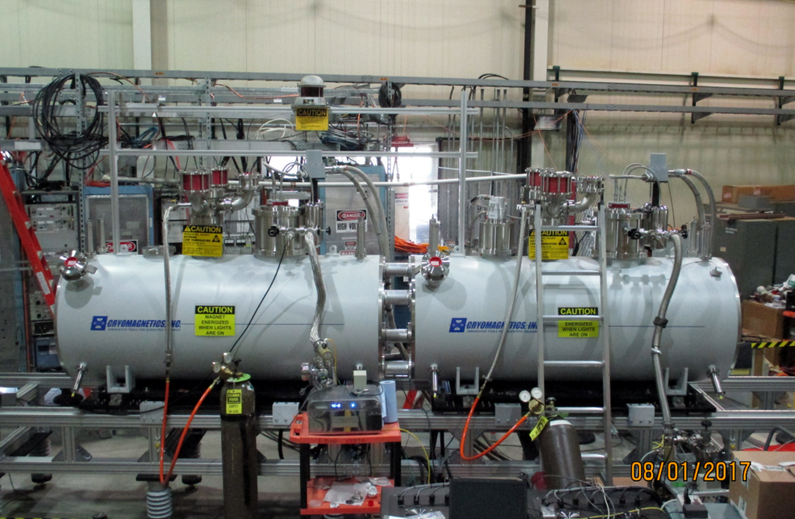
Extended EBIS superconducting solenoids, April 2018
5.0 T field, about 1.0 T field at minimal solenoid separation-30 cm

Slide 55
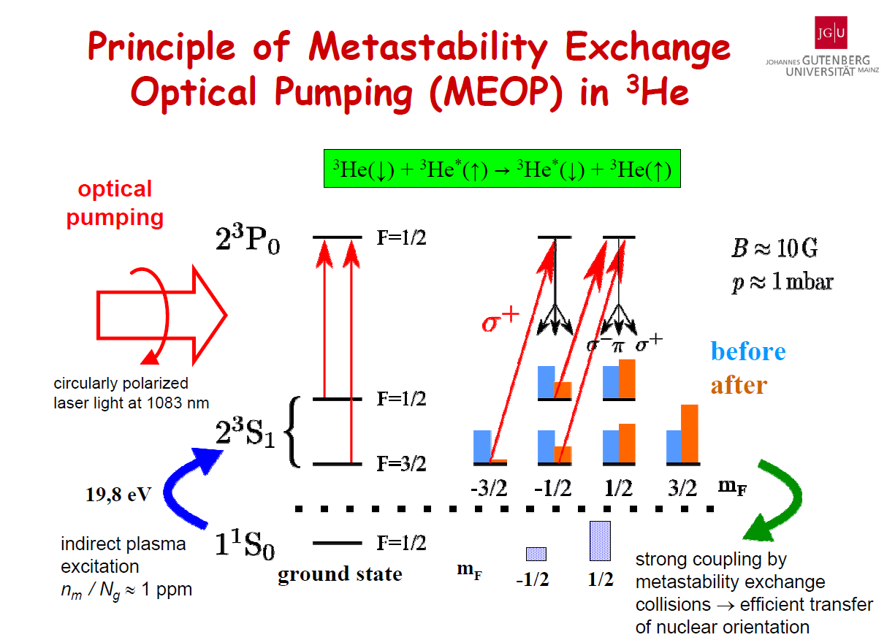
Circular polarized
Laser light at 1083 nm

Slide 56
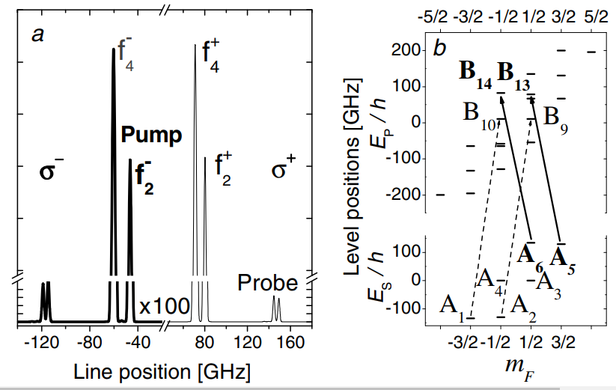
3He optical pumping in high 2.0-5.0T magnetic field

Slide 57
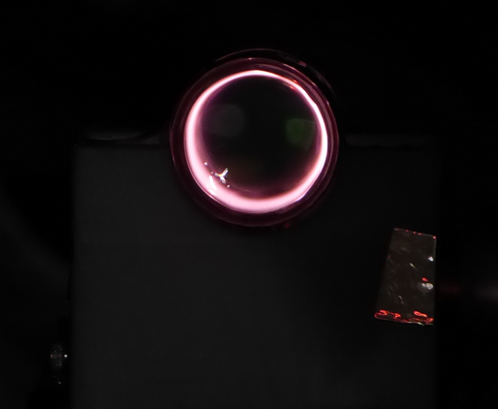
RF-discharge in 3.0 T magnetic field.
3He-cell diameter-25mm
RF-discharge parameters strongly affect maximum polarization.
Optimization of the 3He -cell geometry (smaller diameter?) and electrodes for RF input should improve polarization.

Slide 58
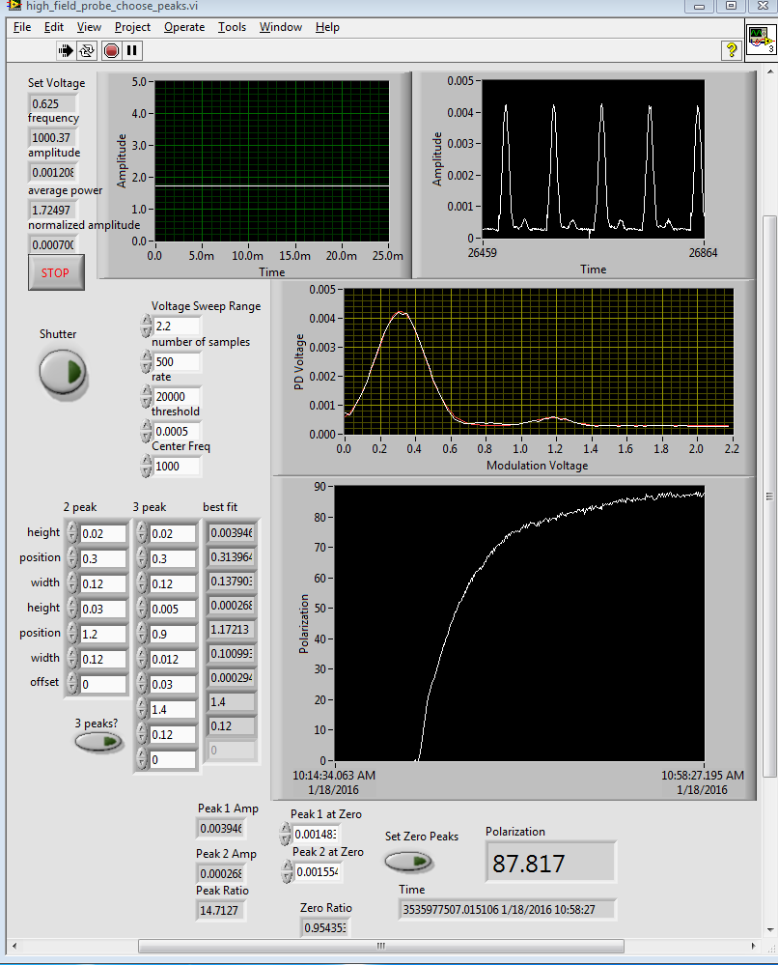
Jan,2016, Sealed cell, OD-30 mm-Pol.- 88%, Field-2.0 T
Probe laser
absorption polarimeter

Slide 59
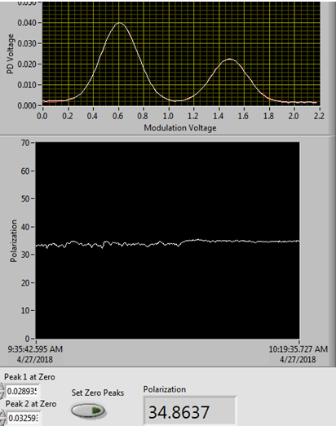
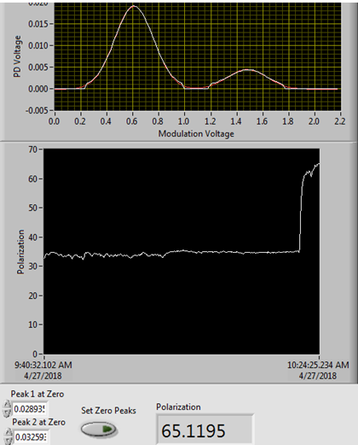
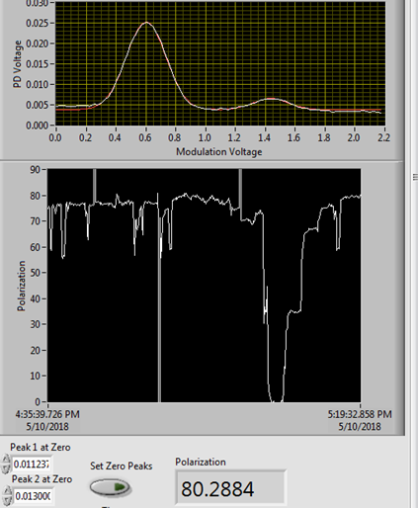
Polarization measurements
Isolation Valve (IV)
open
Isolation Valve (IV)
closed
Polarization
equilibrium
34.9%
65.1%
80.3%

Slide 60
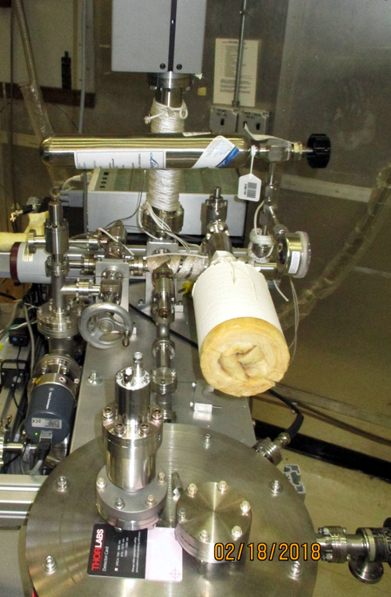

3He-gas purification and filling system
Modified Cryo-pump for 3He
purification and storage

Slide 61
3He –optically-pumped cell in the high magnetic field
3He-cell
Drift tube -40 kV
Insulator
Pulsed valve
Long, small diameter drift tube works like a 3He storage cell, which reduces gas load to the EBIS vacuum system and increases polarization due to ionization localization in the high magnetic field region.

Slide 62

3He⁺⁺ spin rotator and polarimeter in the EBIS HEBT line at 6.0 MeV beam energy
3He-4He-scattering
The development of the 3He polarizing apparatuses, the spin-rotator,
and the nuclear polarimeter at the 3He++ ion beam energy 6.0 MeV
(in the high-energy beam transport line after the EBIS drift-tube Linac)
is funded by the DOE Research and Development Funds for
the Next Generation Nuclear Physics Accelerators Facilities.

Slide 63




Polarization facilities at RHIC
L _{max} = 1.6 × 10³² s⁻¹cm⁻² 50 < √s < 510 GeV
Absolute H-jet
polarimeter
RHIC pC “CNI” polarimeters
RHIC
PHENIX
STAR
Siberian Snakes
Spin Rotators
Pol. H⁻ ion source
EBIS
LINAC
AGS, 24GeV
AGS pC “CNI” polarimeter
200 MeV polarimeter
BOOSTER, 2.5 GeV
Notes:
63

Slide 64
Summary
The RHIC high intensity polarized H- source provides required beam intensity for present RHIC and future high-luminosity eRHIC collider operation.
The polarized ³He⁺⁺ ion source on the basis of new EBIS injector is under development at BNL for future eRHIC collider.
High intensity un-polarized H⁻ ion source development is in progress as a part of Linac intensity upgrade.
Notes:
64

Slide 65
High-intensity un-polarized H⁻ sources
And injector development at BNL

Slide 66

35 keV LEBT upgrade with three sources for Run-2020
Prototype of H⁻ injector for high-energy accelerators, with high cost downtime
Magnetron- S1
OPPIS
To RFQ
Laser beam
23.7 deg. dc bending magnet
Pulsed bending magnet, 45 deg.
Magnetron -S2

Slide 67



BNL magnetron H⁻ ion source
~0.6 sccm
Power efficiency : ~ 100 mA H⁻/1.5 kW
arc-discharge power

Slide 68

Dec.5,2017, Arc-18A, Source current L1-130 mA, current after RFQ L5-80 mA
L1-130 mA
L4 –current
At injection
To RFQ-110 mA
L5-current after RFQ
750 keV energy
Current -80 mA
800 us pulse duration

Slide 69
Polarization phenomena in nuclear physics at low , intermediate energies. IUCF, RCNP, COSY
All “meson factories” PSI, LAMPF, TRIUMF, INR Moscow had polarized proton beams.
Polarized beams in RHIC.
All electron-positron colliders operate with the polarized electron, positron beams.
Proposals.
Polarized beam at SSC.
Polarized beam at TEVATRON (FNAL), 1000GeV
Polarized beam at HERA, 920 GeV
Polarized beam at LHC.
Polarized beam at J-Park, 50 GeV

